Slide 1
Helping autistic children (and others)
We Thrive
November 2023
Clare Ward
Speech and Language Therapist/ CBT/ACT/DBT Practitioner
clarew@specialnetworks.co.uk

Slide 2
Publications
Jessica Kingsley Publishers
2021
Out July 2024

Slide 3
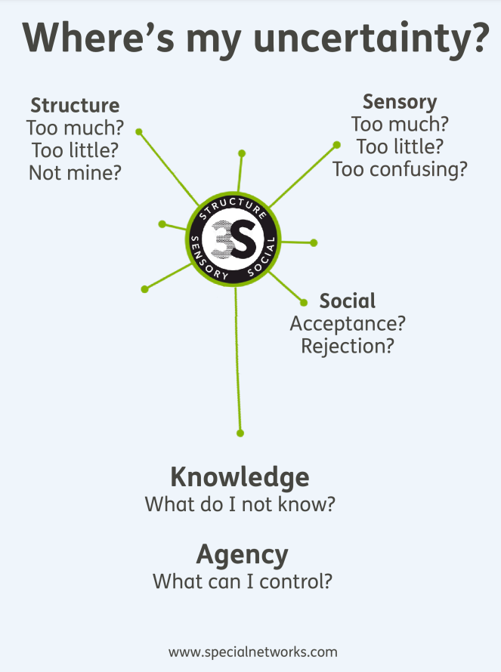
Understanding anxiety and the role of uncertainty

Slide 4
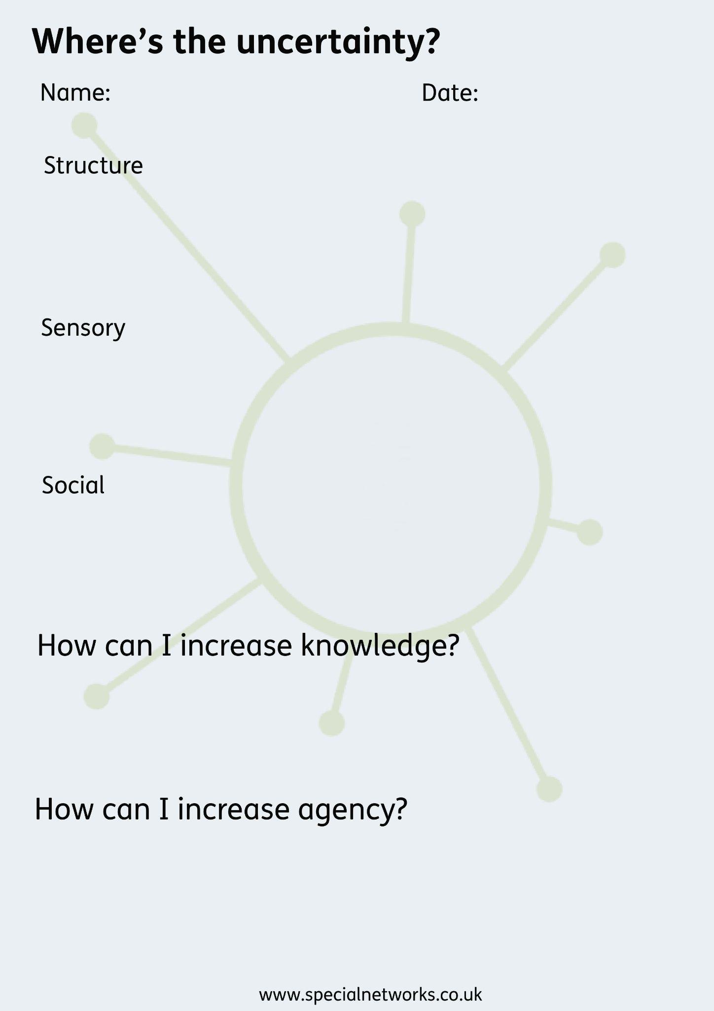
Where’s the uncertainty - framework for understanding behaviour

Slide 5
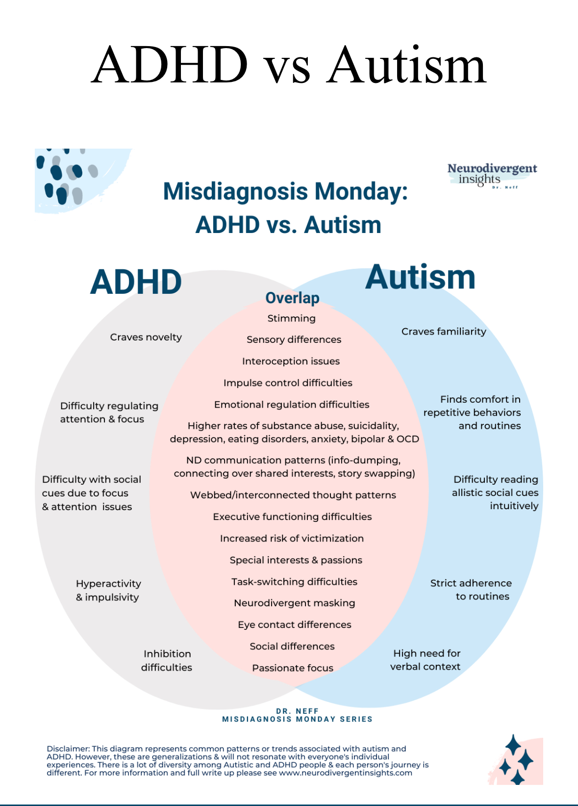

Slide 6
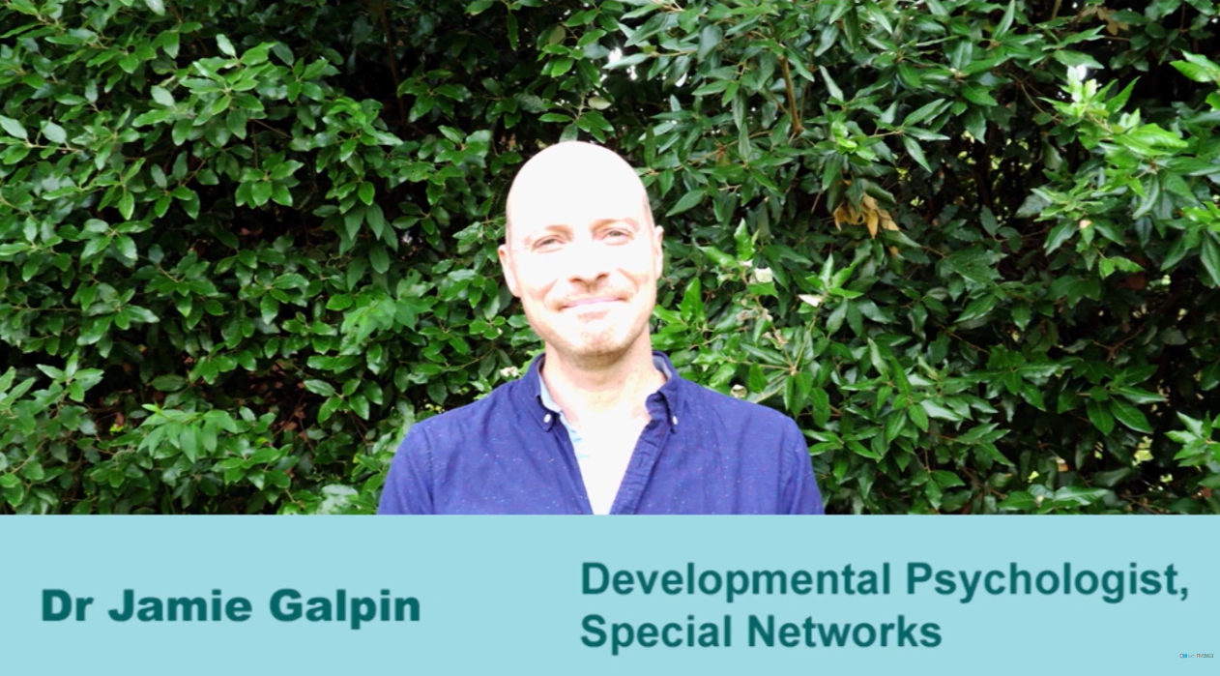
Belonging in school - creating psychological safety
https://inclusion.mrc-cbu.cam.ac.uk/

Slide 7
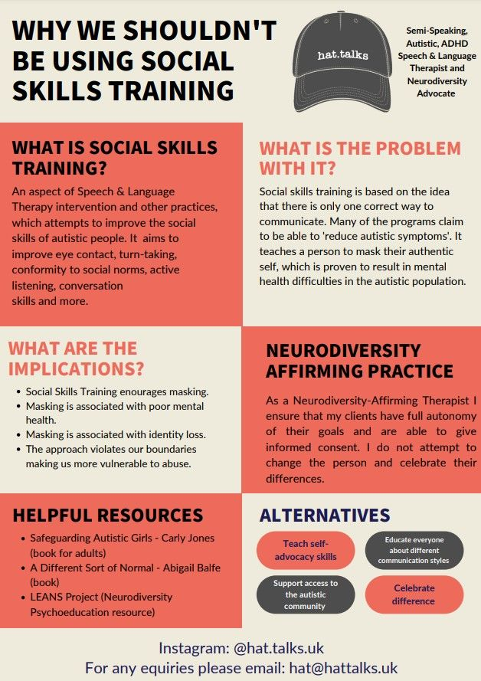

Slide 8
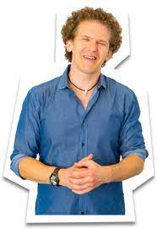
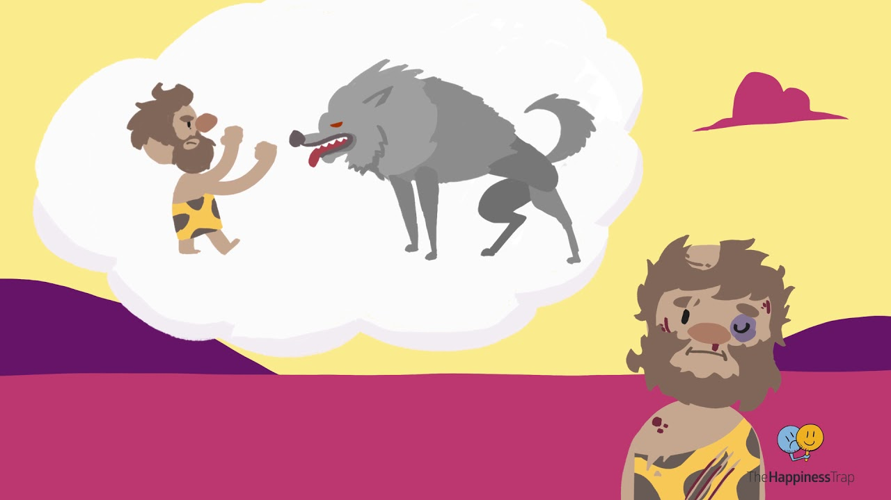
Russ Harris - videos, books, courses
The Evolution of the Human Mind
https://www.youtube.com/watch?v=kv6HkipQcfA

Slide 9
Special Networks
A team of all kinds of minds providing simple, sustainable support.
Individual work: online support for children and young people
Parent work: online support for families
School work: training and support for strategic and senior leaders, teachers and teaching assistants
Consultancy: support for businesses, arts organisations and more to help them create more neuro-inclusive spaces
www.specialnetworks.co.uk

